Slide 1


CSD 212 DIGITAL IMAGE PROCESSING

Slide 2


Research Paper Implementation
LIME : Low Light Image Enhancement via Illumination Map Estimation

Slide 3
Introduction
Enhancing images taken in low-light conditions is essential for computer vision tasks like pedestrian detection and object recognition, which depend on high-quality visual input. Traditional techniques, such as histogram equalization and gamma correction, have notable drawbacks. Histogram equalization can introduce visual artifacts, while gamma correction overlooks spatial context, often producing unnatural results.

Slide 4
Drawbacks of Using Traditional Methods
Direct Amplification Although it is the most intuitive method to recall the visibility of dark regions. But, this operation is not useful as relatively bright regions of image might be saturated and thus lose corresponding details

Slide 5
Drawbacks of Using Traditional Methods
Histogram Equalization It can solve the problem by somehow forcing the image to fall in the range [0,1] , but they focus on contrast enhancement instead of exploiting real illumination causes it has a risk of over-enhancement and under-enhancement.

Slide 6
Drawbacks of Using Traditional Methods
Gamma Correction It is non linear operation on images. The main drawback is that this gamma correction is carried out on each pixel without considering the relationship of a certain pixel with its neighbors, and thus may make enhanced results vulnerable and visually inconsistent with real scenes.

Slide 7

Methodology
Estimation of illumination map The approach is based on the retinex model, where the captured low-light image L is composed of the desired scene R and the illumination map T, as follows

Slide 8
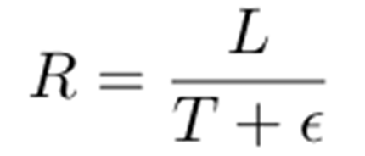
where L and R are the captured image and the desired recovery, respectively. Furthermore, T represents the illumination map, and the operator ◦ means element-wise multiplication. The enhanced image can be obtained by

Slide 9

An initial estimate of the illumination map T(hat) for each pixel p, is obtained as per the following operation

Slide 10
This approach is designed to enhance the illumination of low light images in a non-uniform manner, as opposed to uniformly increasing the overall brightness. It operates on the principle that the illumination at any given pixel can be approximated by the maximum value among its red, green, and blue (R, G, B) channel intensities.

Slide 11
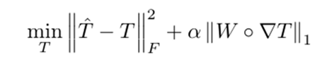
To refine the resulting illumination map—preserving the global structure of the image while simultaneously smoothing out local texture variations—the following optimization problem is formulated and solved.

Slide 12

Solving The Optimization Problem
As the ℓ1 norm is not differentiable, this problem can be solved by using the Alternating Direction Method of Multipliers (ADMM). Since both the terms in the objective function involve T, an auxiliary variable G is introduced for making the problem separable. Accordingly, ∇T = G is added as a constraint.

Slide 13
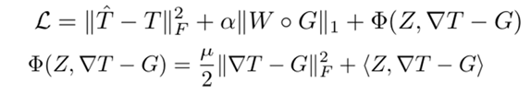
The augmented Lagrangian function for this problem can be formulated as

Slide 14

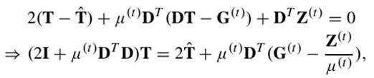
T sub problem - Collecting the T involved terms gives the problem as follows
this problem is classical least squares problem hence the solution can be computed through differentiating the above equation wrt T and setting it to zero.

Slide 15
D contains Dh and Dv, which are the Toeplitz matrices from the discrete gradient operators with forward difference. Directly calculating the inverse of 2T+µ(t)D^TD is an intuitive way to accomplish this job. However, the matrix inverse is computationally expensive, especially for large matrices like DTD. Fortunately, by assuming circular boundary conditions, we can apply 2D FFT techniques on the above problem, which enables us to compute the solution fast. Consequently, we have

Slide 16


Slide 17

G sub problem - Dropping the terms unrelated to G leads to the following optimization problem
The closed form solution can be easily obtained by performing the shrinkage operation Sε>0[·] represents the shrinkage operator, the definition of which on scalars
Sε[a] = sgn(a) max(|a| − ε,0)

Slide 18

Z and µ Sub-Problem- The following equations are followed for updating Z and µ

Slide 19

Weighting Strategies-For the structure-aware refinement on the initial illumination map, the possible weighting strategies can be used for the design of W, such that W = reshape(w), where w is given by

Slide 20
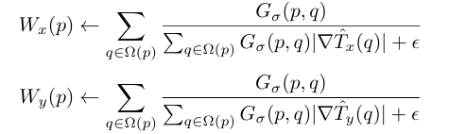
This strategy involves the use of relative total variation, so for each location, the weight is set as
where p,q denote two pixels, Ω(p) denotes the region around pixel p and depends on the size of the kernel.

Slide 21

Post Processing Techniques After obtaining the refined illumination map T, gamma correction is applied on T, in order to improve the visual perception of the result, as follows

Slide 22
Denoising
Denoising techniques are required to further improve the visual quality.A bilateral filter (BF) is a nonlinear, edge-preserving, smoothing filter which has been used in our case.

Slide 23

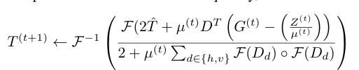
Algorithm LIME
Low-light image L, positive coefficients α,γ,ρ, and µ(0)
Initialize: k = 0, G(0) = Z(0) = 0 ∈ R2M×N
Estimate the initial illumination map ˆ T on L using
Update T(k+1) using

Slide 24

Update G(k+1) using shrinkage operation
Update Z(k+1) and µ(k+1)
k = k + 1
Apply Gamma correction
Denoise the image using Bilateral Filtering

Slide 25
Conclusion
In this study, we present a method for enhancing low-light images by estimating an illumination map. The results obtained using our approach are consistent with those reported in foundational studies. Our objective is to offer a clearer and more accessible explanation of the core principles involved.

Slide 26
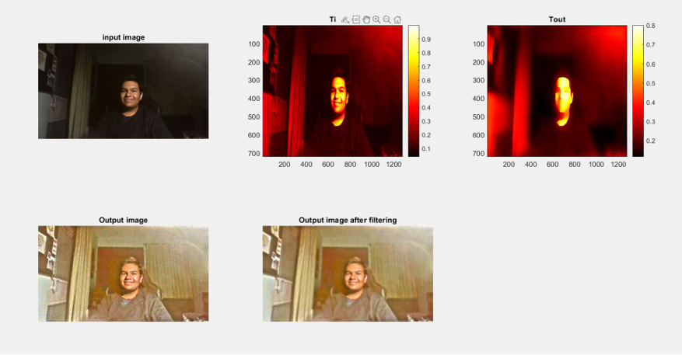
Results

Slide 27
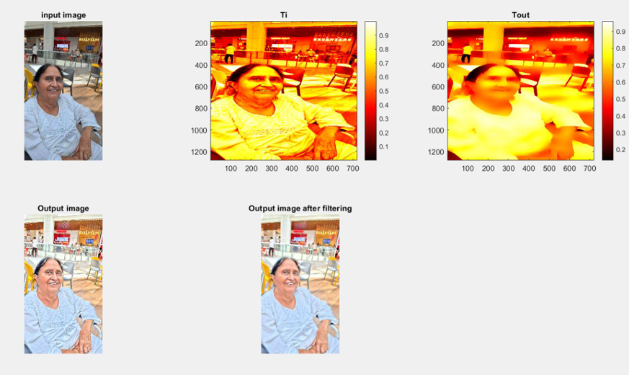
Results

Slide 28
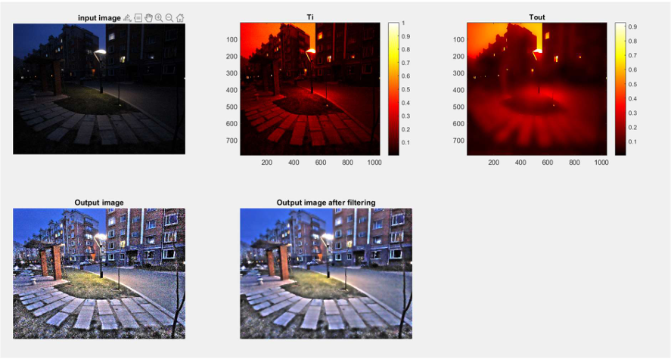
Results

Slide 29
I would like to thank Dr. Saurabh Janardan Shigwan for his invaluable guidance, support, and encouragement were instrumental throughout the project. His insights and expertise helped shape the direction and quality of this work.

